Slide 1
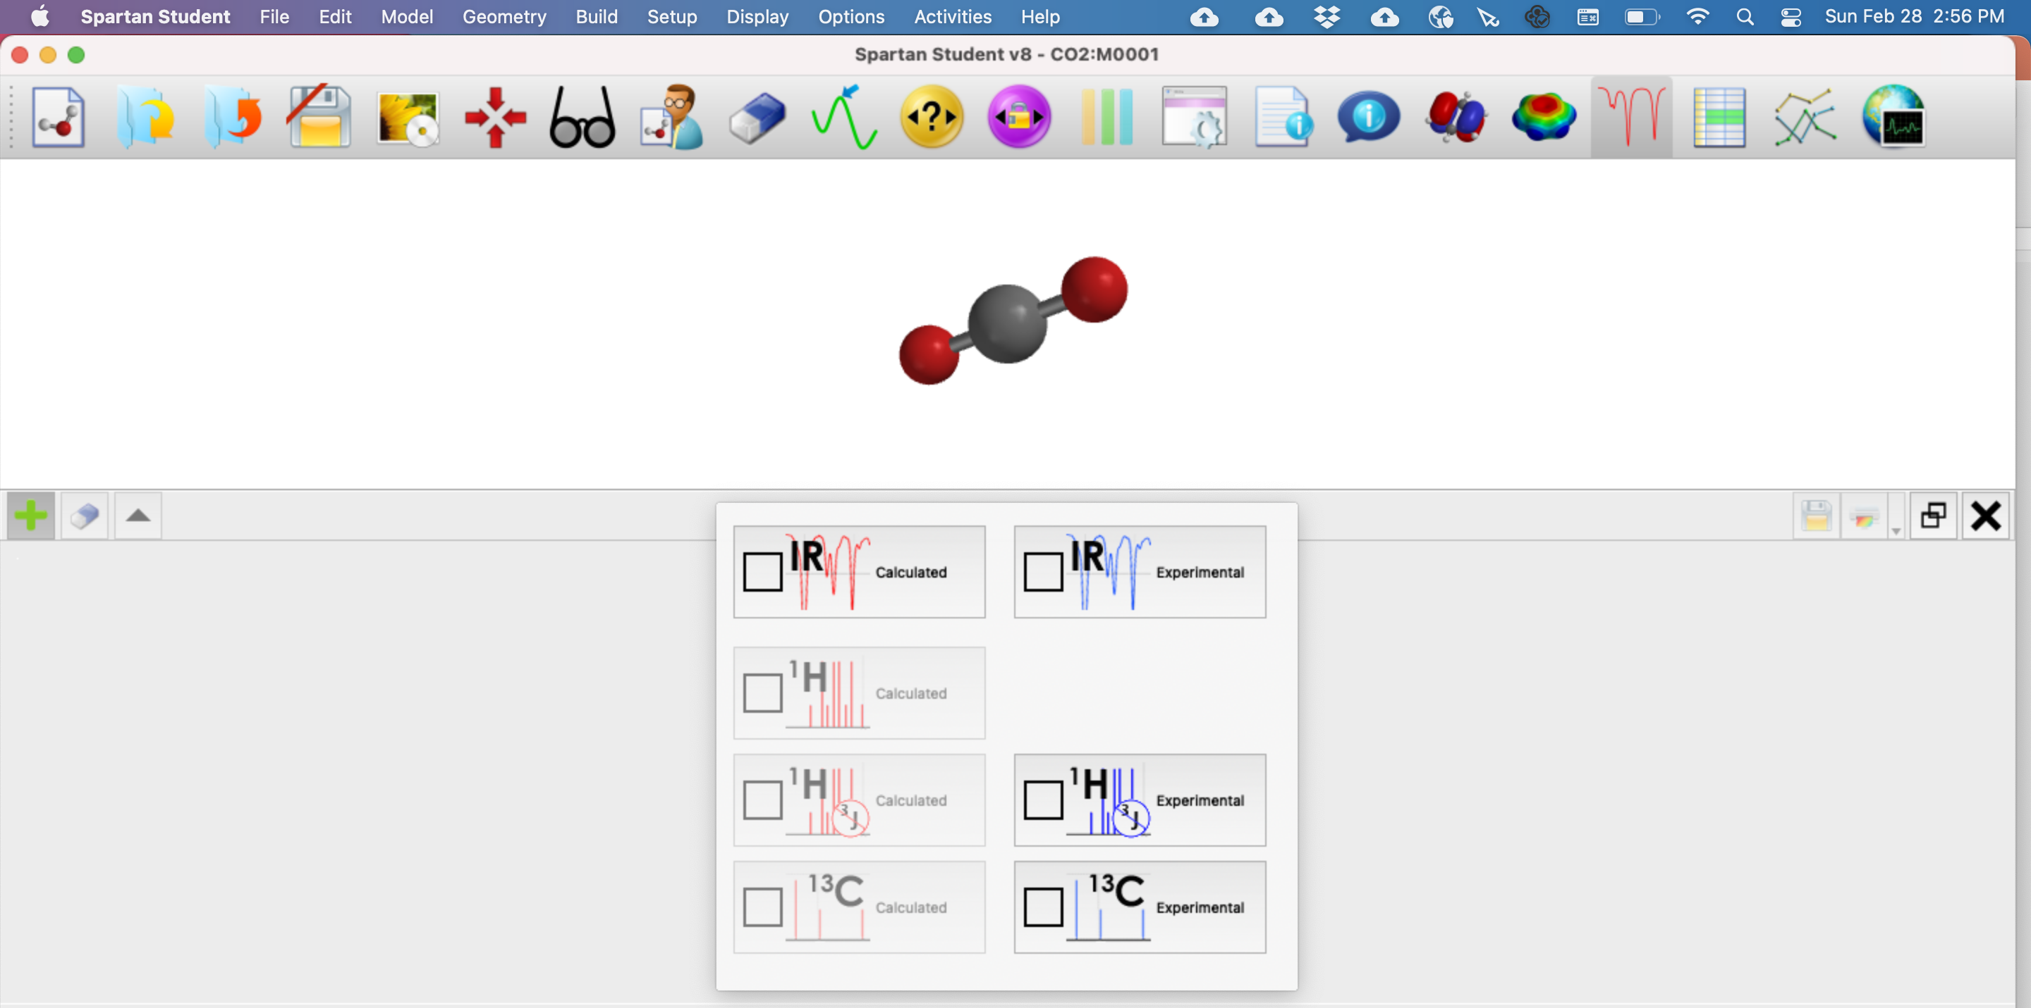
Recap: IR spectra in Spartan
X

Slide 2
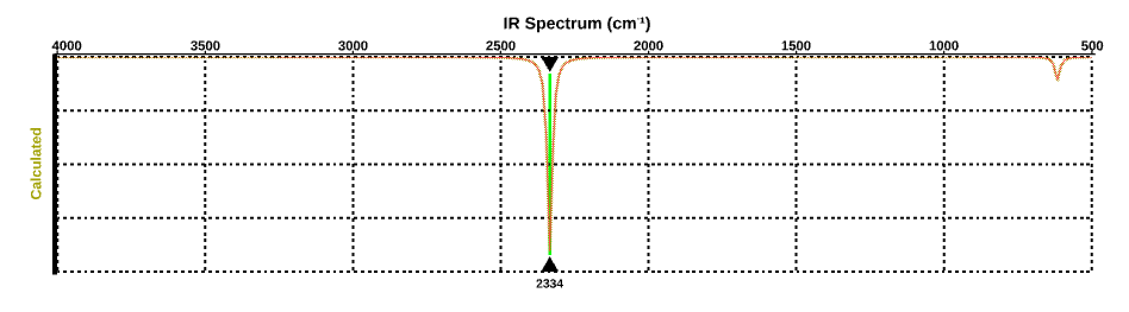
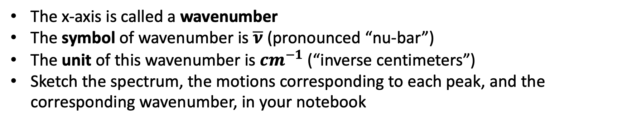

Getting used to IR spectra
$\overline{ν} (cm^{−1})$
The x-axis is called a wavenumber
The symbol of wavenumber is $\overline{ν}$ (pronounced “nu-bar”)
The unit of this wavenumber is $cm^{−1}$ (“inverse centimeters”)
Sketch the spectrum, the motions corresponding to each peak, and the corresponding wavenumber, in your notebook

Slide 3
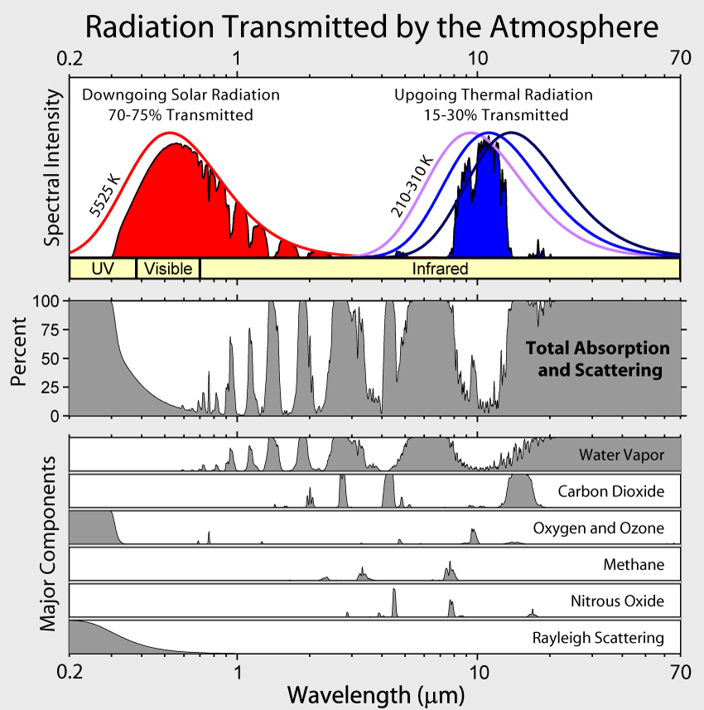
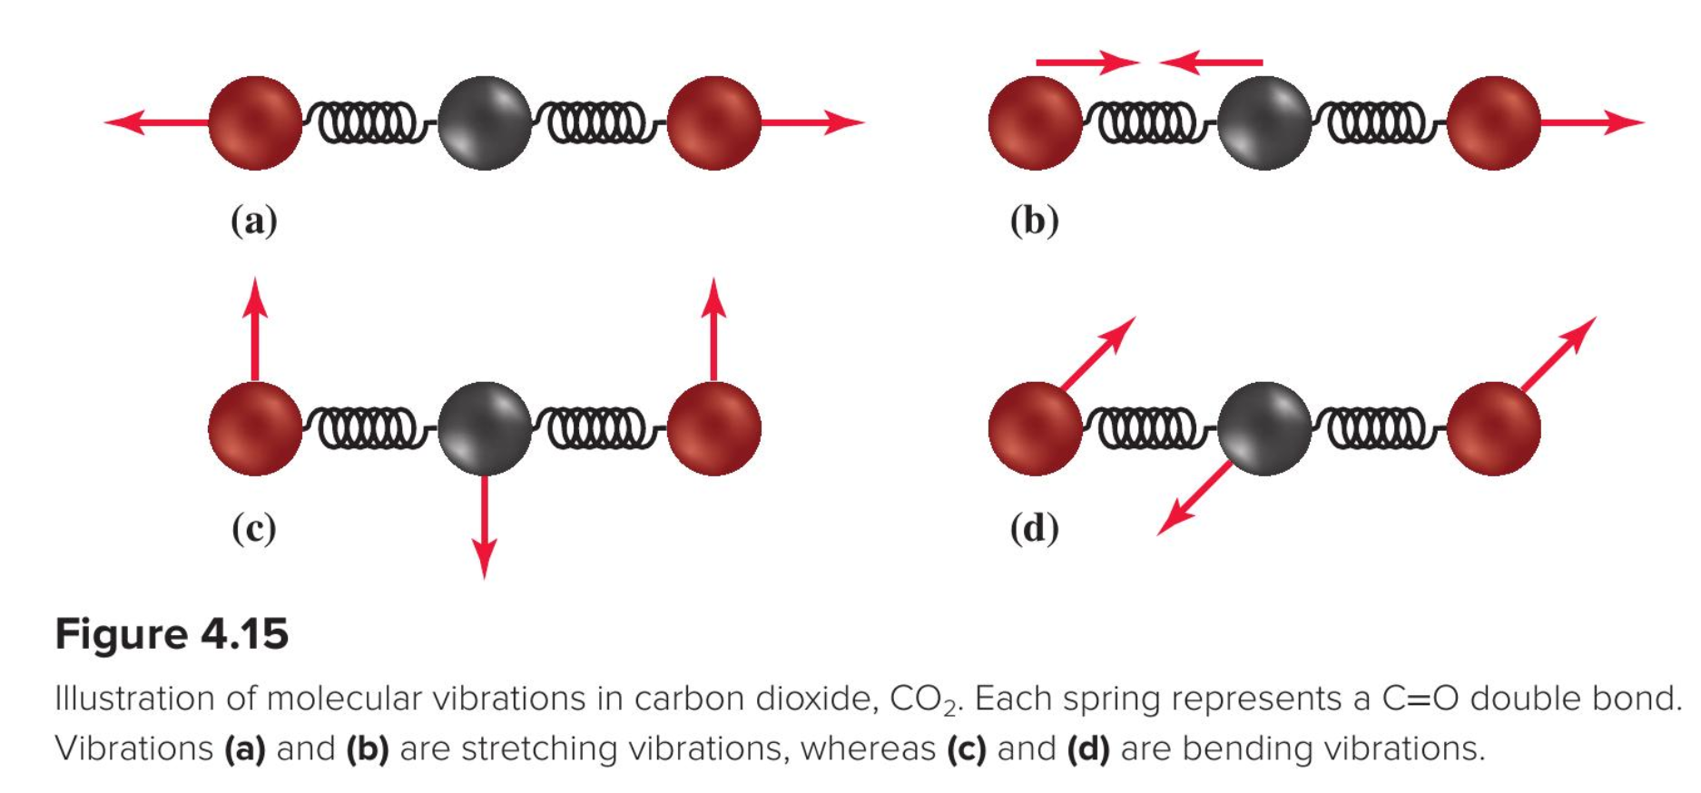
Asymmetric stretch and bend in atmospheric spectra
Asymmetric stretch
Bend

Slide 4
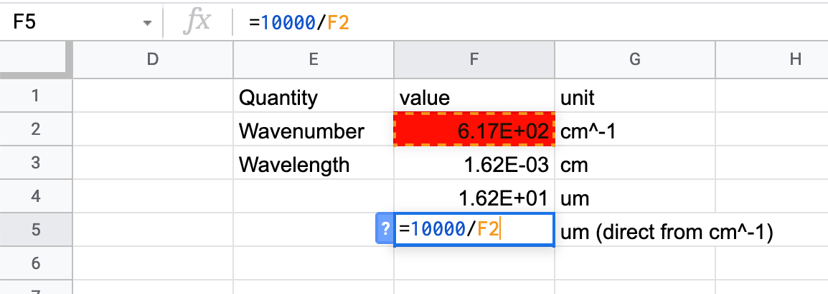
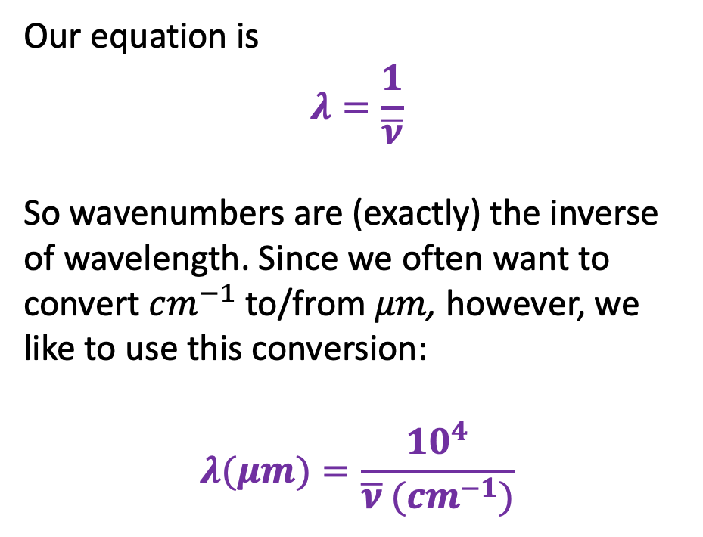
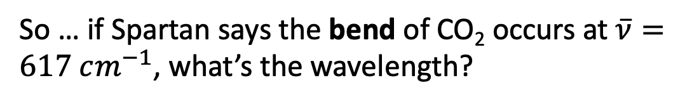
Converting wavenumber to wavelength
Our equation is
$$λ=\frac{1}{\overline{ν}}$$
So wavenumbers are (exactly) the inverse of wavelength. Since we often want to convert $cm^{−1}$ to/from $μm$, however, we like to use this conversion:
$$λ(μm)=\frac{10^{4}}{\overline{ν} (cm^{−1})}$$
So … if Spartan says the bend of CO₂ occurs at $\overline{ν}=617 cm^{−1}$, what’s the wavelength?

Slide 5
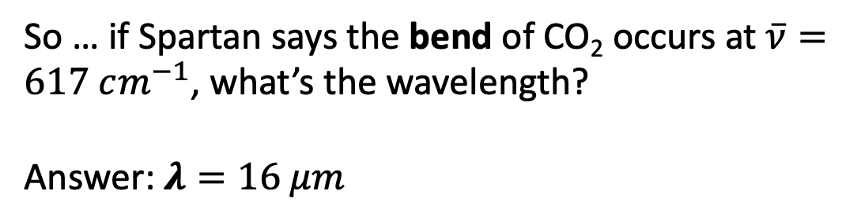
Converting wavenumber to wavelength
Our equation is
$$λ=\frac{1}{\overline{ν}}$$
So wavenumbers are (exactly) the inverse of wavelength. Since we often want to convert $cm^{−1}$ to/from $μm$, however, we like to use this conversion:
$$λ(μm)=\frac{10^{4}}{\overline{ν} (cm^{−1})}$$
So … if Spartan says the bend of CO₂ occurs at $\overline{ν}=617 cm^{−1}$, what’s the wavelength?
Answer: $λ=16 μm$

Slide 6
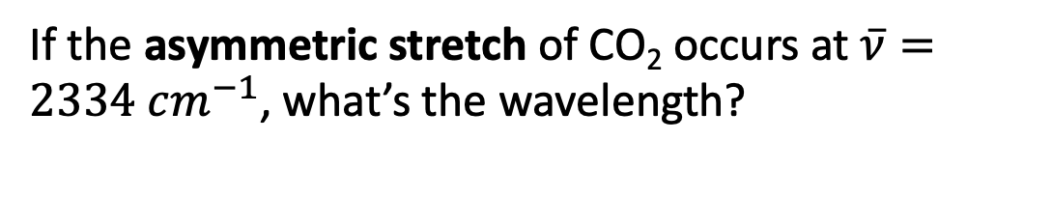
Converting wavenumber to wavelength
Our equation is
$$λ=\frac{1}{\overline{ν}}$$
So wavenumbers are (exactly) the inverse of wavelength. Since we often want to convert $cm^{−1}$ to/from $μm$, however, we like to use this conversion:
$$λ(μm)=\frac{10^{4}}{\overline{ν} (cm^{−1})}$$
If the asymmetric stretch of CO₂ occurs at $\overline{ν}=2334 cm^{−1}$, what’s the wavelength?

Slide 7
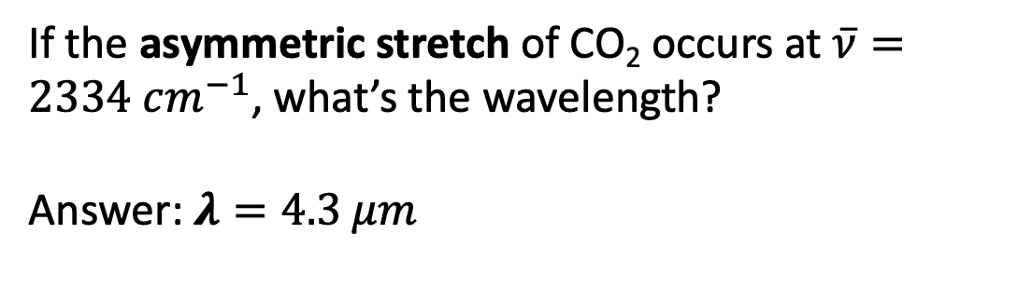
Converting wavenumber to wavelength
Our equation is
$$λ=\frac{1}{\overline{ν}}$$
So wavenumbers are (exactly) the inverse of wavelength. Since we often want to convert $cm^{−1}$ to/from $μm$, however, we like to use this conversion:
$$λ(μm)=\frac{10^{4}}{\overline{ν} (cm^{−1})}$$
If the asymmetric stretch of CO₂ occurs at $\overline{ν}=2334 cm^{−1}$, what’s the wavelength?
Answer: $λ=4.3 μm$

Slide 8
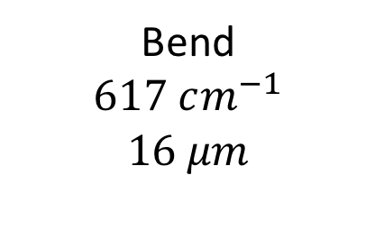
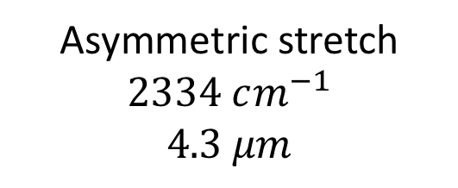
Summary so far
Asymmetric stretch
$$2334 cm^{−1}$$
$$4.3 μm$$
Bend
$$617 cm^{−1}$$
$$16 μm$$

Slide 9
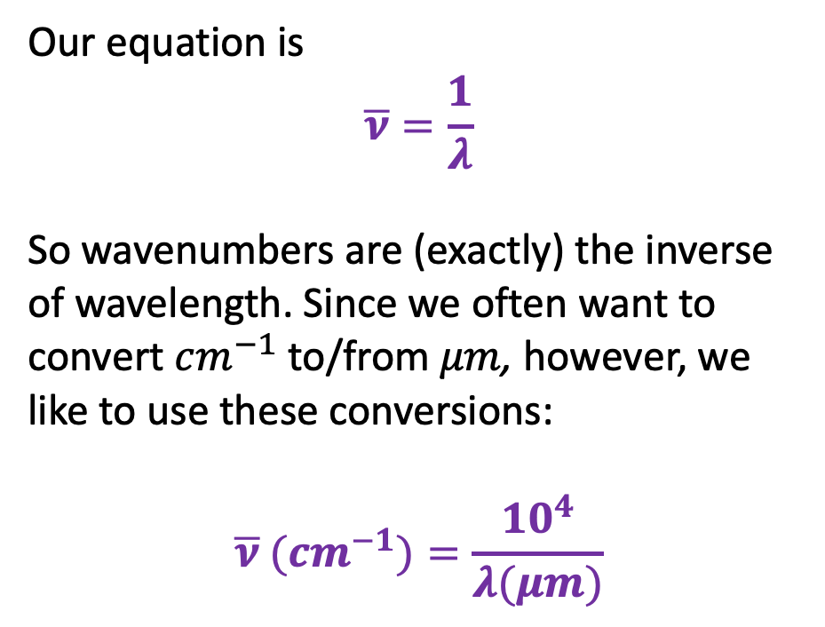

Converting wavelength to wavenumber
Our equation is
$$\overline{ν}=\frac{1}{λ}$$
So wavenumbers are (exactly) the inverse of wavelength. Since we often want to convert $cm^{−1}$ to/from $μm$, however, we like to use these conversions:
$$\overline{ν} (cm^{−1})=\frac{10^{4}}{λ(μm)}$$
What’s the wavenumber corresponding to $λ_{max}$ for a blackbody like the earth (at 290 K)?

Slide 10
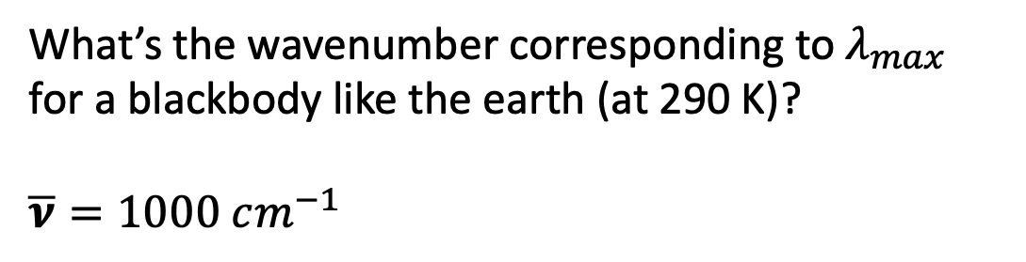
Converting wavelength to wavenumber
Our equation is
$$\overline{ν}=\frac{1}{λ}$$
So wavenumbers are (exactly) the inverse of wavelength. Since we often want to convert $cm^{−1}$ to/from $μm$, however, we like to use these conversions:
$$\overline{ν} (cm^{−1})=\frac{10^{4}}{λ(μm)}$$
What’s the wavenumber corresponding to $λ_{max}$ for a blackbody like the earth (at 290 K)?
$\overline{ν}=1000 cm^{−1}$

